Slide 1


SMART CITY ENABLER
SMART CITY ENABLER
NIMBLE MAPS
Fabrikam, Inc.
Providing efficient & practical solution to everyday life issues
A new way to engage with customers from across the globe.

Slide 2


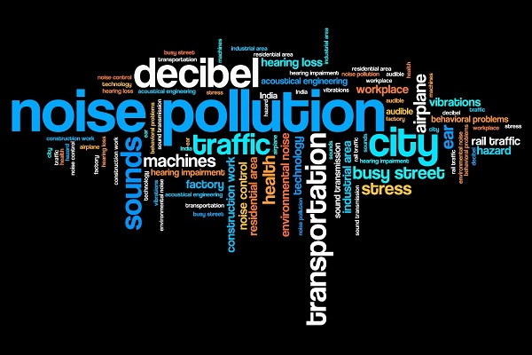
Problem Statement
Tracking of potholes and measurement of Noise level (dB) & illumination level (Lux) in cities and mapping these on Google maps – Smart City enabler

Slide 3
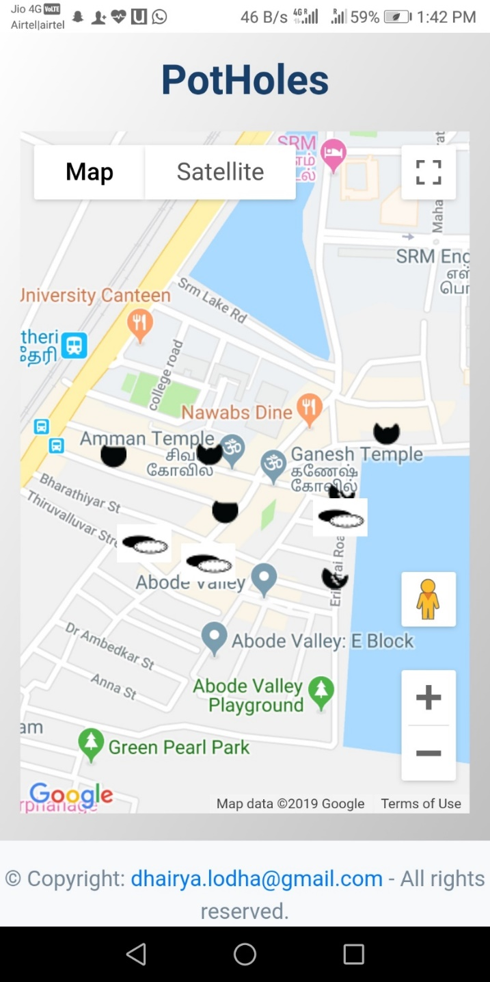




Benefits : - Improved Locomotion - Reducing Accident Frequency - Prioritize Road repairs - Road safety - Reducing Manhole accidents. - Real time tracking of pothole repairs.
Category 1
Category 2
Emergency
A repair is required within a calendar month.
A repair is required within a week.
Immediate response is required.
Pothole Mapping

Slide 4
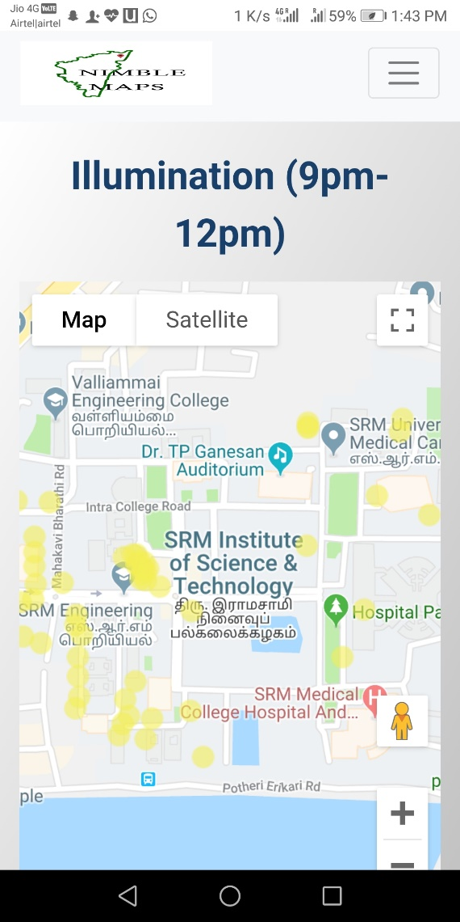


Benefits : - Public Safety : Women safety - 24 x 7 record of area - Working status of street lights - Classification of areas based on Lux
Category 1
Category 2
Functioning street light
Faulty street light (Repairs required)
Illumination level (Lux)

Slide 5
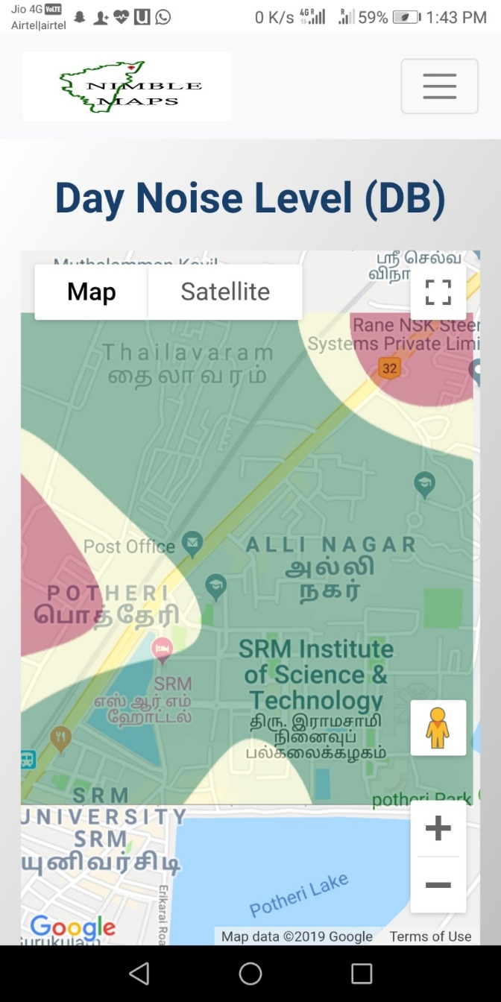



Benefits : - Classification of area in decibel level - Real Estate Solutions - Depicting Noise level on Google maps which is accessible with ease and no extra-cost
Category 1
Category 2
Emergency
0-60 dB
61-80 dB
Above 80 dB
Measurement of Noise Level(dB)

Slide 6
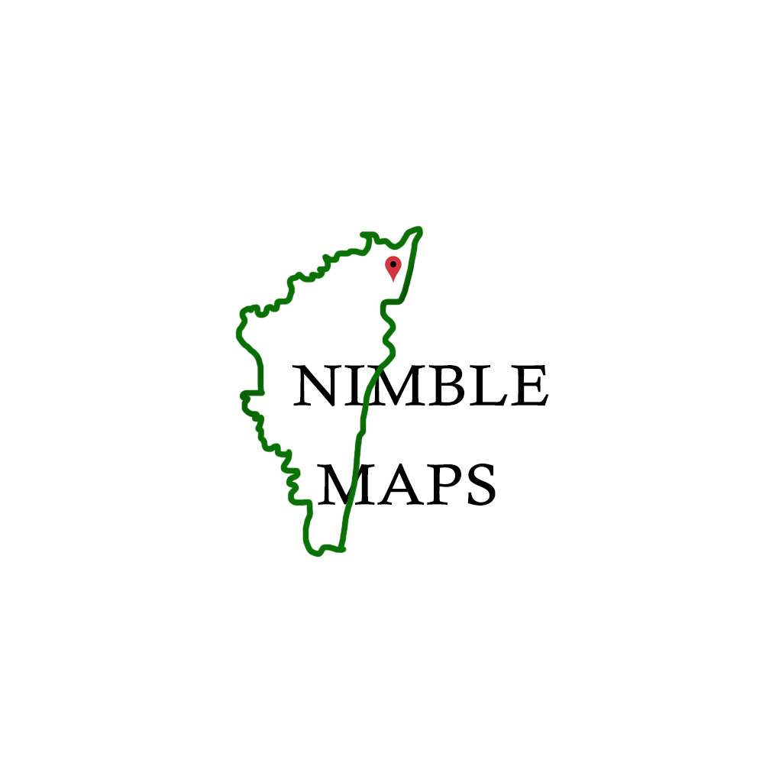




Product
Unique
First to Market
Reliable
User-Friendly
Nimble Maps – The project aims to integrate the google maps with webapp and use machine learning model to solve the problems and make the model smarter.

Slide 7
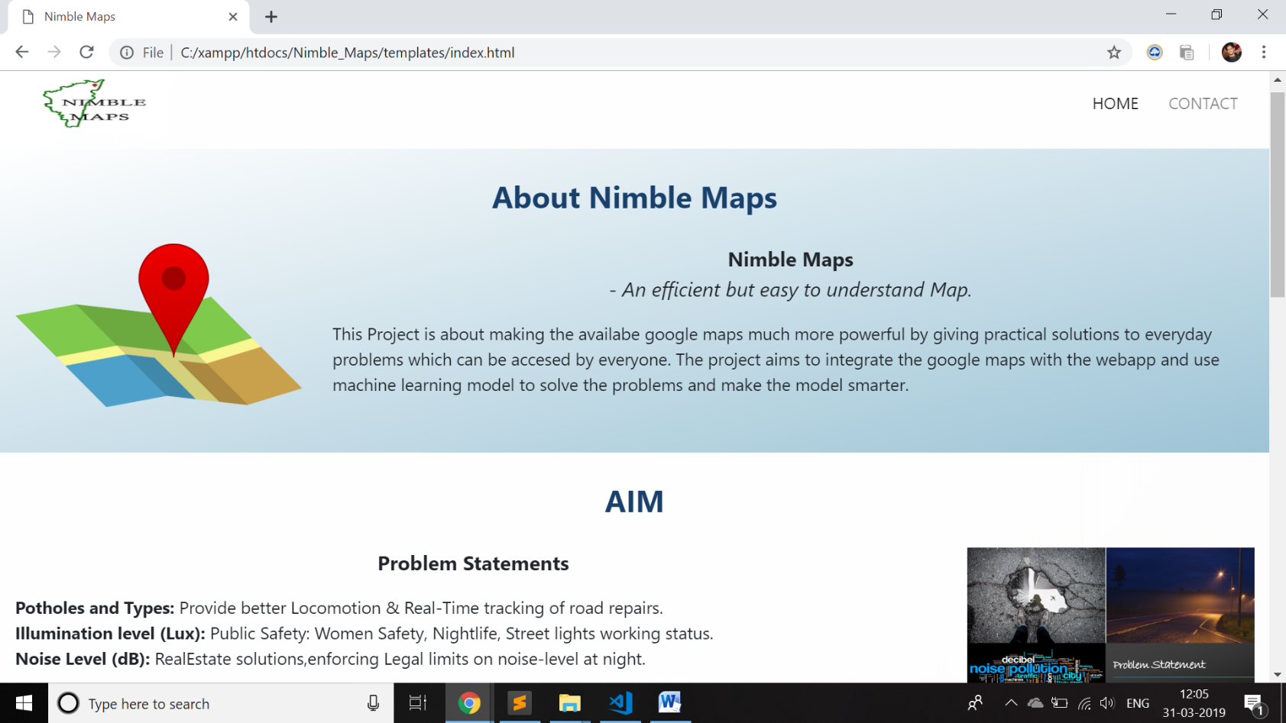
Web Application
Emphasizing on our main benefits
Other benefits include
Reducing accidents and facilitate transport system.
Enchancing public safety.
Empowering maps with practical and safe solutions to everyday problem.
Real Estate feature increment.
Crowd Validation and categorisation by ML Techniques for smart model.

Slide 8



Business Model
There is an opportunity for success
Direct sale
Venture Consultation
Subscriptional
Ad stream
Targeting major Map Leagues
Real-estate

Slide 9
Market Opportunity
Expected Users
Merge Opportunity
154.4M
70%
90%
Our Accuracy
Number of users using Google Maps is increasing exponentially.
Around 70% of unique Google maps API prototypes gets merged into Google
Machine Learning models accurately works with probability of 90%

Slide 10
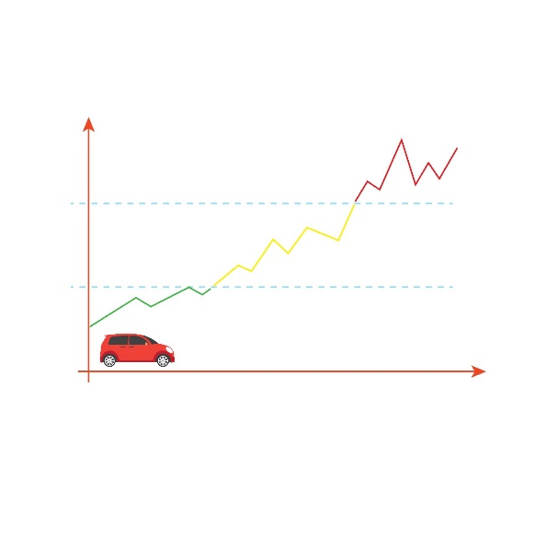
Growth Strategy
How will we scale in the future
Phase 1
Phase 2
Phase 3
DATA COLLECTION:
Existing model can be used with other sources to collect data such as:
1-CCTV
2-DashCams
3-Drones
FUTURE ASPECTS:
Gyroscope can be used to detect road conditions and map them through intensity of vibrations.
Collaborations with companies like snapchat, mapmyindia, google maps,etc
Collaborations with government for faster and efficient solutions to major problems.

Slide 11
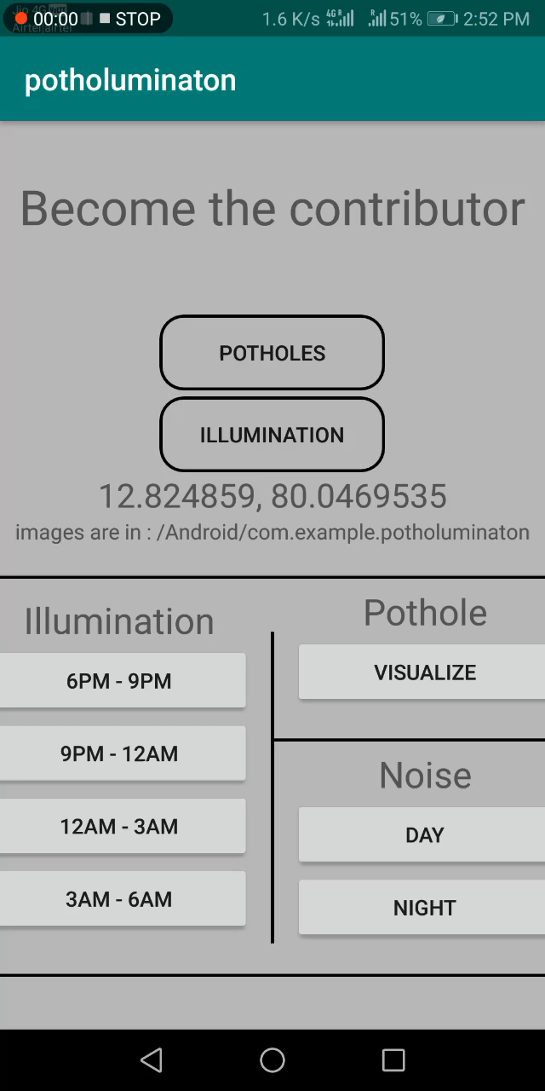
Nimble Map App
- Providing efficient & practical solution to everyday life issues

